Slide 1
Solar Power Rechargeable
LED LAMP
TQ Systems
By:
Ta’Ziyah Wright
Quinton Driggs

Slide 2
Overview
The Problem
Initial Designs
Requirements
Identified Issues
Proposed Design
Costs
Summary

Slide 3
Problem:
Small remote village with limited electricity
Objective is to develop cleaner, safer portable lighting for the villagers
Must be efficient, low cost, and use rechargeable batteries

Slide 4
Requirements
Category | Requirement
Efficiency | 75% efficient
Cost | Under $50 per unit
Time Duration | Lasts 8-12 hours
Batteries | Removable and rechargeable
Operation | Emit light only when ambient lighting is not sufficient for tasks
Usability | Portable lighting source

Slide 5
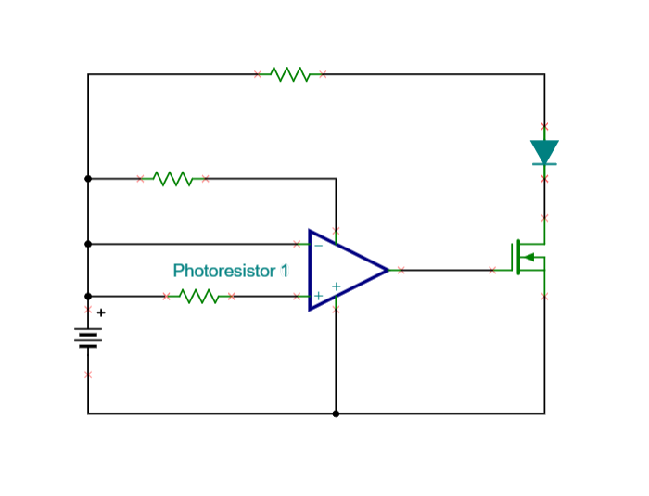
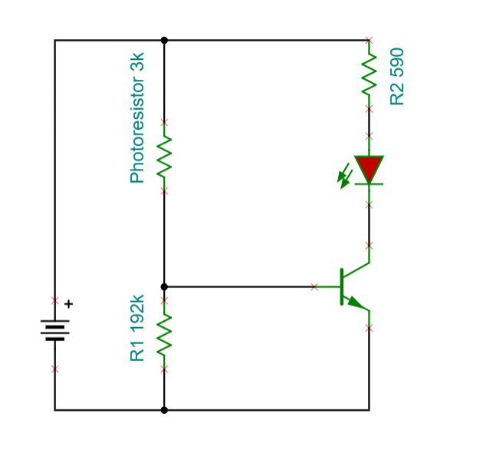
Initial Designs (Trade Studies)
Op-amp into MOSFET (trade #1)
Voltage divider into npn transistor (trade #2)
Trade #1
Trade #2

Slide 6
Trade #1
This design did not provide enough voltage to the LED for it to get to full brightness
We switched out the MOSFET for a transistor that was rated for less power and was better suited for this application
This circuit was overly complicated and could be simplified

Slide 7
Trade #2
Trade #2 worked as planned however it was not efficient
The voltage divider consumed most of the power
We revised the design by lowering the resistances of the voltage divider
We were then able to decrease the source voltage which required less batteries which made the design lower cost.

Slide 8
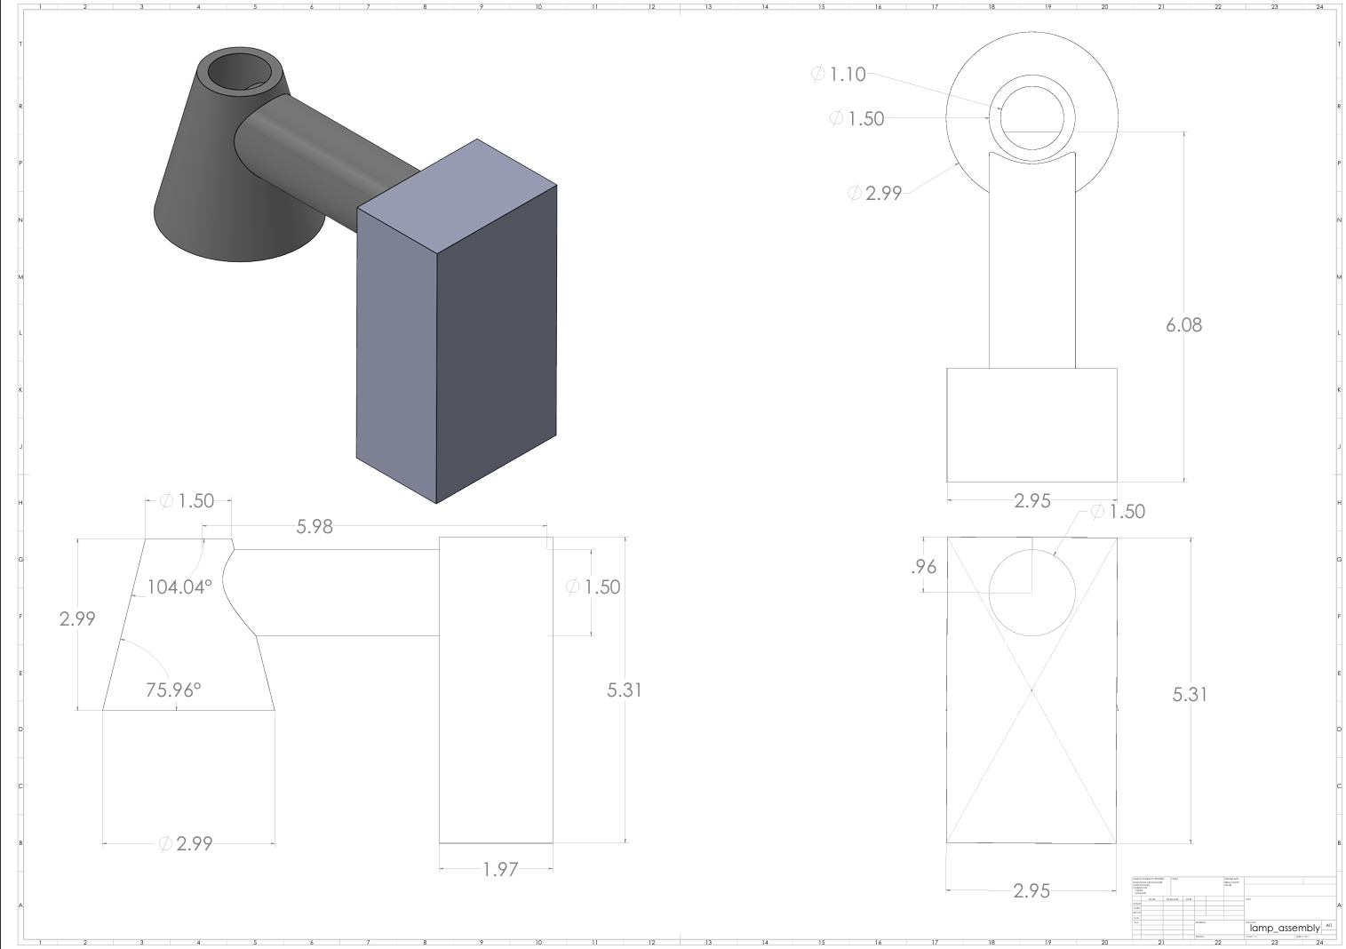
Proposed Packaging Design:

Slide 9
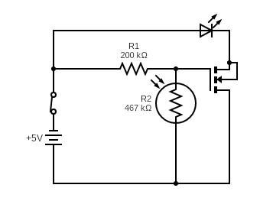
Final Proposed Electrical Design

Slide 10
LEDs and Batteries
Cool White LED BA9s 1.2 W
Batteries are 18650, 3.7 V, 9900mAh

Slide 11
Costs: Total: $29.17
Item | Qty | Unit Price | Extended Price
LED | 1 | $3.99 | $3.99
Batteries | 2 | $5.50 | $11.00
Light Bulb Socket | 1 | $1.80 | $1.80
Rocker Switch | 1 | $1.72 | $1.72
2x2 Protoboard | 1 | $2.59 | $2.59
Box for Base | 1 | $1.99 | $1.99
LDR 30-50k Ohm | 1 | $2.78 | $2.78
3-D Printed Base | 1 | $3.00 | $3.00

Slide 12
Summary:
Item | Requirement | Actual
Efficiency | 75% efficient | 96.3% efficient
Cost | Under $50 per unit | $29.17 per unit
Time Duration | Lasts 8-12 hours | Lasts 61.1 hours
Batteries | Removable and rechargeable | Achieved
Operation | Emit light only when ambient lighting is not sufficient for tasks | Achieved
Usability | Portable lighting source | Achieved
The design met all the customer requirements.

